Slide 1

Machine Learning Practices in Network Traffic across Data Centers
Jasmine Mou jasmine.mou@bytedance.com
System Technologies and Engineering, ByteDance
Notes:
单击此处添加文本

Slide 2

Agenda
Context & Challenge
Problem Definitions
Machine Learning Approaches and Applications
Data Pipeline
Summary
Notes:
单击此处添加文本

Slide 3
Context - Network traffic model
Network traffic flow
Dimensions defining the network traffic
  Location: src/dst -- Backbone, data center, group unit location, TOR, server
  Time: timestamp
  route: capacity
  product pairs: compute & storage, Message Queue, Yarn, HDFS,...
  traffic
Top to down: overall traffic
-> pairs of product from pairs of source and destination
-> services.
Bidirectional.
The number of dimensions increases the complexity for network traffic management.
3
Notes:
单击此处添加文本

Slide 4
Context - Unexpected traffic
Delivery goals in Networking
ensure service stability.
catch up with service traffic growth -- may consider the capacity expansion when necessary.
Cross Data Center traffic
Traffic within DC is always more preferable than traffic across DC.
Need to limit and optimize such traffic to save the costs.
Expected vs Unexpected
Expected: predefined list of route location and product pair.
Unexpected: traffic caused by those that are not on the list.
4
Notes:
单击此处添加文本

Slide 5
Context - Major Contributors
When "unexpected" traffic happens, Network engineers need to know
Sudden increase in unexpected traffic in this route.
influence of unexpected traffic vs overall traffic.
time window, especially during the peak hours.
which product pairs are the major contributors.
5
Notes:
单击此处添加文本

Slide 6
Context - Resource planning
The need to expand the route capacity ahead of time
Deliver smoother network experience.
Resource planning workflow
Collect the future deployment needs for product pairs.
Check historical traffic data, and servers resource usage and utilization.
Estimate number of servers needed to supply.
Challenge: mixed deployment on the same server.
6
Notes:
单击此处添加文本

Slide 7
Problem Definitions
We want to Answer 3 Questions:
1. Can we discover the trend in traffic, esp. long-term, and provide forecast to alert when the traffic hit the watermark level in recent future (~60 days)?
2. Can we find out the major contributors to the traffic, so to locate the high priority focus?
3. Can we have a projection tool to check capacity capability when updating the number of servers available for a product pair on src and dst ends?
7
Notes:
with so many questions in mind, we condense and classify them into 3 types of questions, so to be solved and answered by 3 models

Slide 8
Machine Learning Apps - Toolbox
Statistical features
Quantitative stats: mean/median/mode, variance/std. dev.
Data distribution: shape, kurtosis, skewness.
Regression modeling
Given independent variables Xs, predict the dependant variable y.
Time series modeling
Subcategory of regression modeling.
Variable X are autocorrelated in time.
Anomaly detection
Identification of unexpected events that are deviated from the observed "normal" events.
8

Slide 9
Machine Learning Apps
Tools alignments: algorithms & statistical profiling
Topic | Q1. Trend & Forecast | Q2. Major Contributors | Q3. Resource Projection
Statistical Features | ✓ | ✓ | ✓
Time Series | ✓
Anomaly Detection | ✓
Regressions | ✓ |  | ✓
9
Notes:
单击此处添加文本

Slide 10
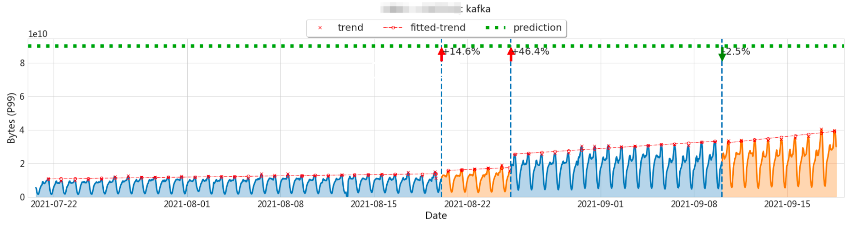
Machine Learning Apps - Trend & Forecast
Workflow
1. Extract statistical features: hourly P99.
2. Apply time series algorithm
Decompose data into trend, seasonality, noise.
Cluster to discover series with common patterns.
3. Apply anomaly detection: use change points detection to segment the data.
4. Apply lasso regression over peaks from last trend to forecast.
10
Notes:
单击此处添加文本

Slide 11
Machine Learning Apps - Major Contributors
Workflow
1. Extract statistical features: daily max.
2. Calculate statistics
(a) Ratios of unexpected vs overall.
(b) Ring ratios of (a) to reflect the chronological changes.
3. Rank by the statistics calculated in step 2 and pick top N entities (products, services,...).
11
Notes:
单击此处添加文本

Slide 12
Machine Learning Apps - Resource Projection
Workflow
1. Extract statistical features: counts of hosts on both src & dst for each product pair.
2. Fit Regression methods (Linear Regression, Ridge Regression, ...) to project the capacity using historical counts & capacity data for each product pair.
12
Notes:
单击此处添加文本

Slide 13
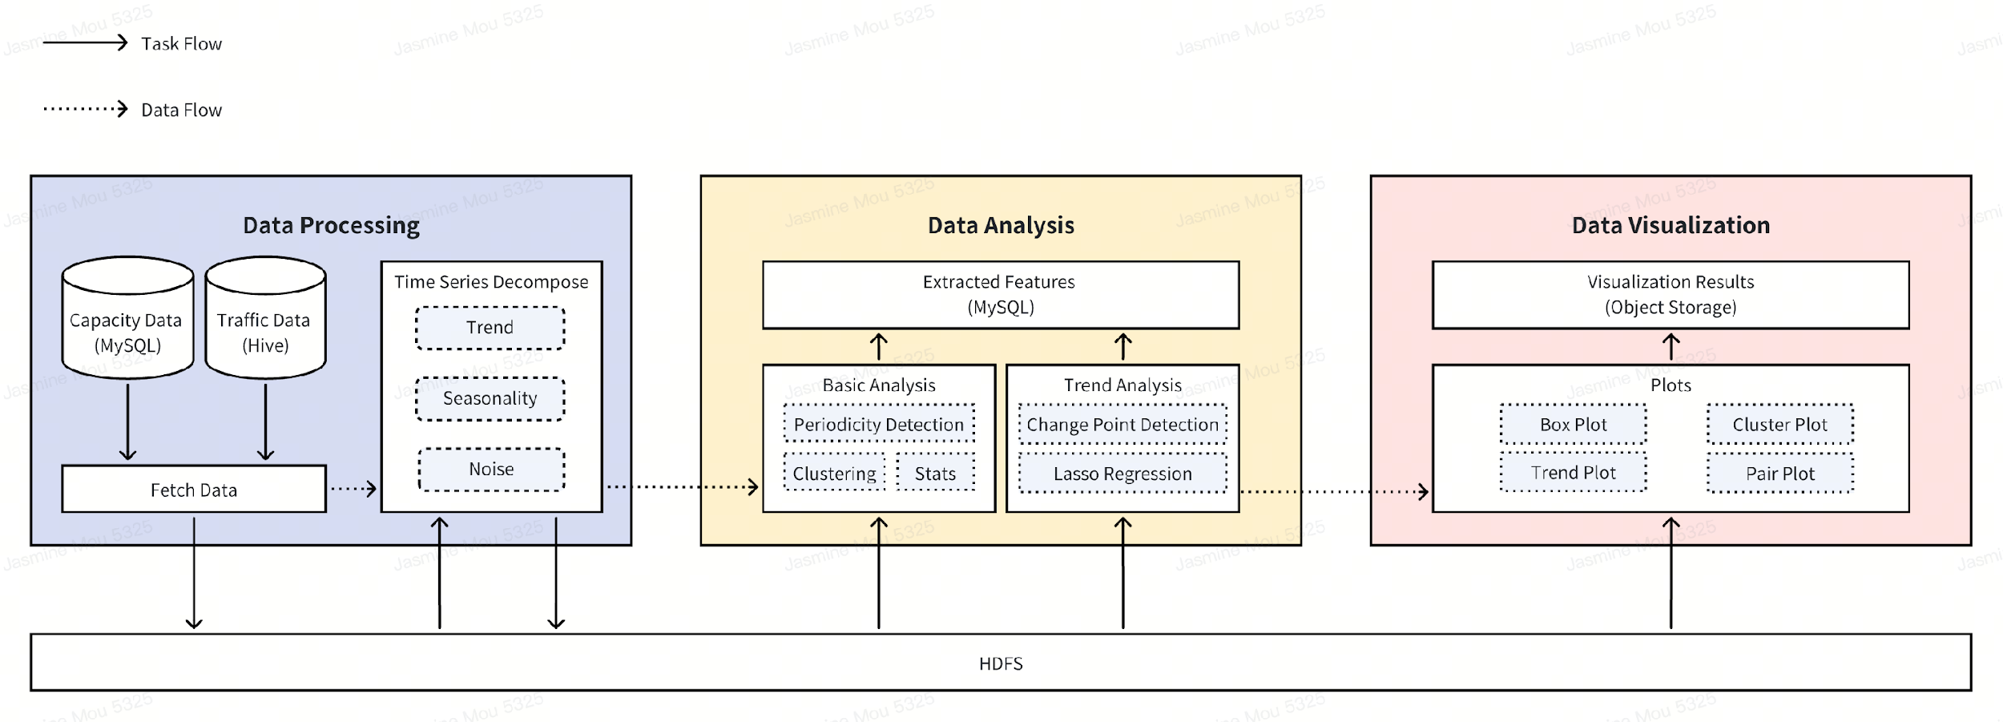
Data Pipeline
Pipeline Diagram
Data processing steps
1. Clean & Aggregate data
Clean & Aggregate: remove negatives; interpolate to fill NA.
Transform: different granularity, traffic data, product pairs data.
2. Apply the algorithm workflow.
3. Save results (calculation, data viz).
13
Notes:
单击此处添加文本

Slide 14
Data Pipeline
Computation & Scheduled Jobs
Internal DAG platform designed specifically for machine learning jobs
Update frequency
Freq/Question | Q1. Trend & Forecast | Q2. Major Contributors | Q3. Resource Projection
Scheduled Jobs | Daily | Daily
On-demand |  |  | ✓
14
Notes:
单击此处添加文本

Slide 15
Data Pipeline
Storage
Input: MySQL, Hive.
Output
  HDFS - cached intermediate results.
  MySQL - analytical summary & time series features.
  Object Storage - data viz.
Output format
Medium/Question | Q1. Trend & Forecast | Q2. Major Contributors | Q3. Resource Projection
Tables in DB | ✓ | ✓ | ✓
Message subscription | Customized Chatbot
RESTful API |  |  | ✓
15
Notes:
单击此处添加文本

Slide 16
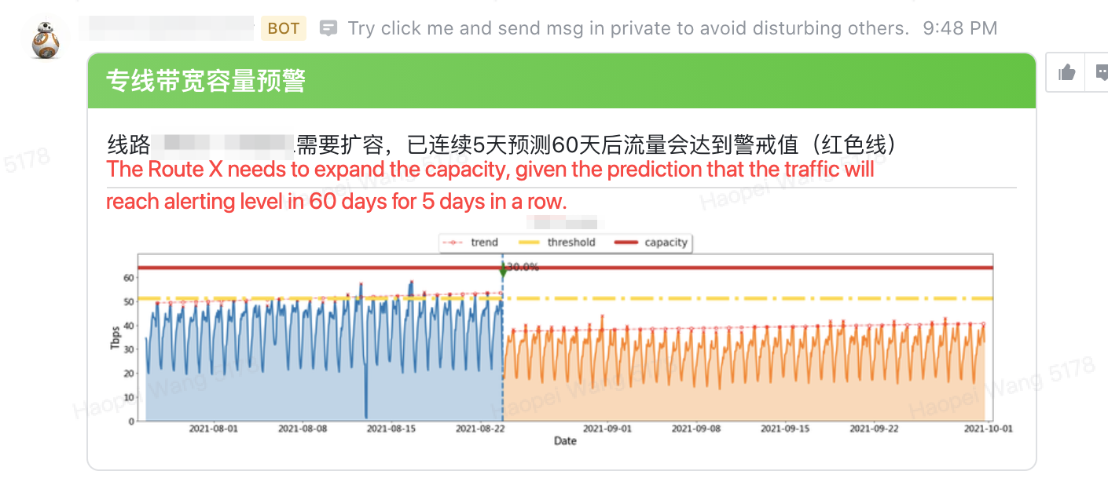
Data Pipeline
16
Notes:
单击此处添加文本

Slide 17
Summary
Context & challenges
  Network traffic models
  Save the cost by increasing the supply & decreasing the demand
  Unexpected traffic
  Resource planning
Define the problems into 3 model apps
  Trend & forecast
  Major contributors
  Resource projections
Machine learning apps
Data pipeline: workflow, computing & storage.
17
Notes:
we are not talking about specific models today, but more on the framework setup.

Slide 18
Questions?
Notes:
单击此处添加文本

